Slide 1
How CAT Models Work: Exposure Data
TIGERRISK PARTNERS

Slide 2
Agenda
Raw Data – Different Shapes and Sizes
Basic Policy Info
Geographic Data
Financial Terms and Coverages
Primary Risk Characteristics
Secondary Risk Characteristics
Lines of Businesses
Data Checks and Edits
Intro to How Models Read Exposure
Useful Resources

Slide 3
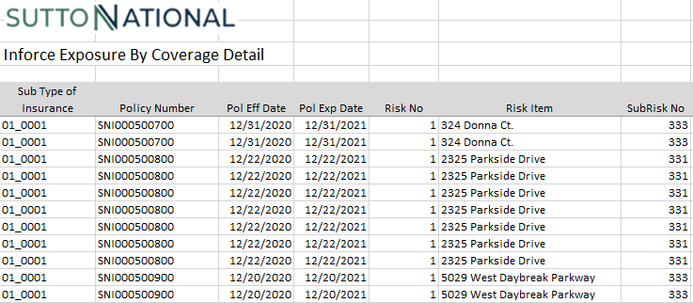
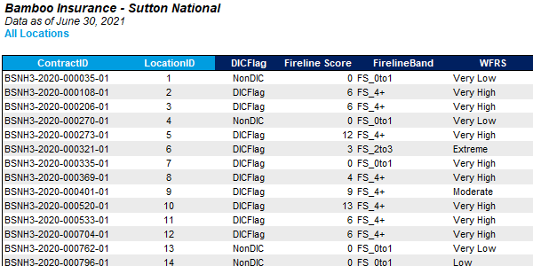
Raw Data – Different Shapes and Sizes
No Two Clients will Share Identical Raw Data Templates
Raw data contents depends on
Data capture capabilities
Relevance
Client’s definitions
Most raw data will have
Policy / location info
Address info
Financial values
Location characteristics
User defined fields
Fields not used in models
Missing data
Important to capture as much data as possible
For this presentation, we will be using typical naming conventions – see later slides

Slide 4
Basic Policy Info
Policy Info is Usually Found in the First few Columns of Raw Data
Policy ID / policy name / contract ID
Identifier for a single policy
Usually a number, but can contain letters to differentiate types of policies
Location ID / location name
Identifier for a single location
Usually a number, but can contain letters to differentiate types of locations
Can have multiple locations for one policy
Inception date
Date the policy goes into effect
Expiration date
Date the policy expires
Typically one year after inception date
User ID / user text
Any additional information the client want to provide
Could be anything

Slide 5
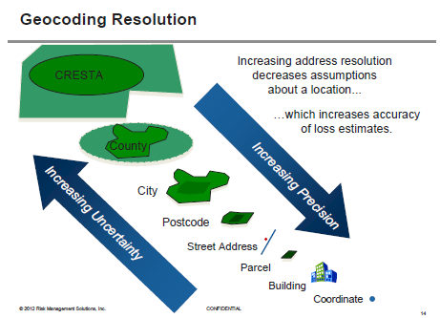
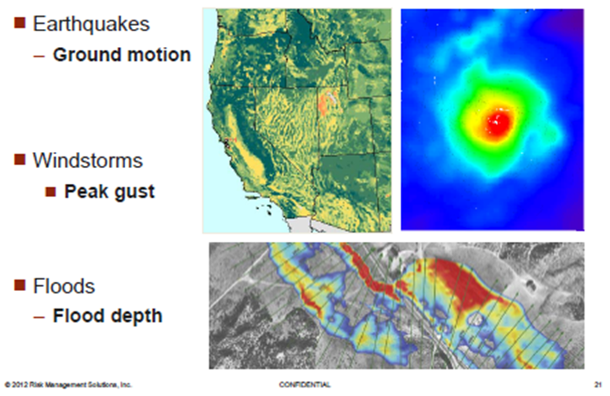
Geographic Data
Any Info that Tells Us Where the Risk is
Basic input information (lowest to highest resolution)
Country
State
County
Zip / Postal Code
Street Address
Latitude / Longitude
Translation process (Geocoding)
Address match information
Resolution issue by peril
Significance for modeling
Hazard lookup
Loss calculation issues
REQUIRED
(AIR and RMS)
REQUIRED
(RMS Only)

Slide 6

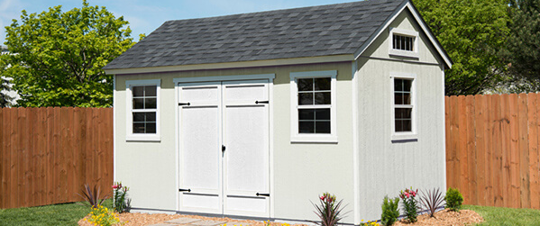


Financial Terms - Coverages
Important to Identify What Columns Apply to What Coverage
Policy Values
TIV
Coverage A – Buildings
Coverage B – Other Structures
Coverage C – Contents
Coverage D – Time Element / Business Interruption
Coverage E & F – Sometimes included but not used in the models
Policy Limits
Total Limit
Limit A – Buildings
Limit B – Other Structures
Limit C – Contents
Limit D – Time Element / Business Interruption
Limit E & F – Sometimes included but not used in the models
Premium
Not directly used by the models but is helpful to include
A
B
C
D

Slide 7
Financial Terms - Deductibles
It’s Important to Communicate with the Client to Accurately Represent Their Data in the Models
Deductibles
Can be a percent or a dollar amount
Can be used only for specified perils
If this is the case, it is typically split between wind deductibles and all other peril (AOP) deductibles
Can be applied to the entire location or specific coverages
The models will want you to specify deductible type
Example
Say a client supplies us the following columns for deductibles:
Hurricane_ded
Named_storm_ded
Wind_ded
Aop_ded
Which one should you use when building your hurricane portfolio? Earthquake? Convective storm?
In this scenario, the client wanted us to use a hierarchy – use one when the others were zero and do the same for the rest of the list.

Slide 8
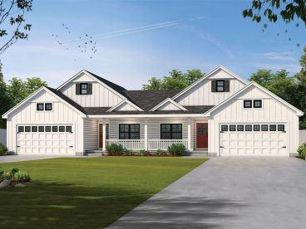
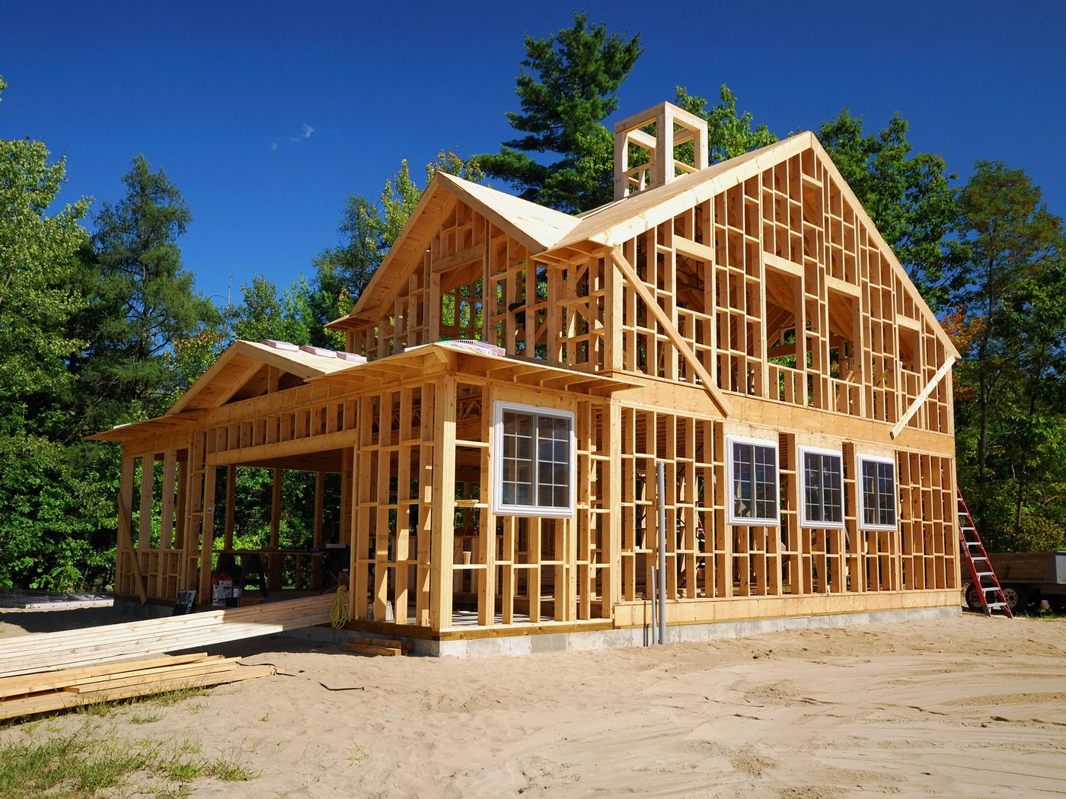
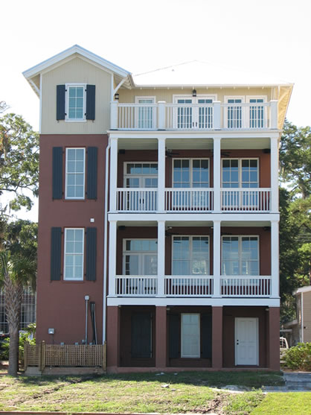
Primary Modifiers / Characteristics
The Models Will Need this Info in order to Run
Construction
What the structure is made of
Typically one of the following
Wood
Masonry
Metal
Concrete
Occupancy
What the structure is used for
Typically split between residential and commercial
Year built
Year the structure was built
Stories
Number of stories of the structure
Square Footage
Not actually necessary to include, but does play a reasonable factor

Slide 9


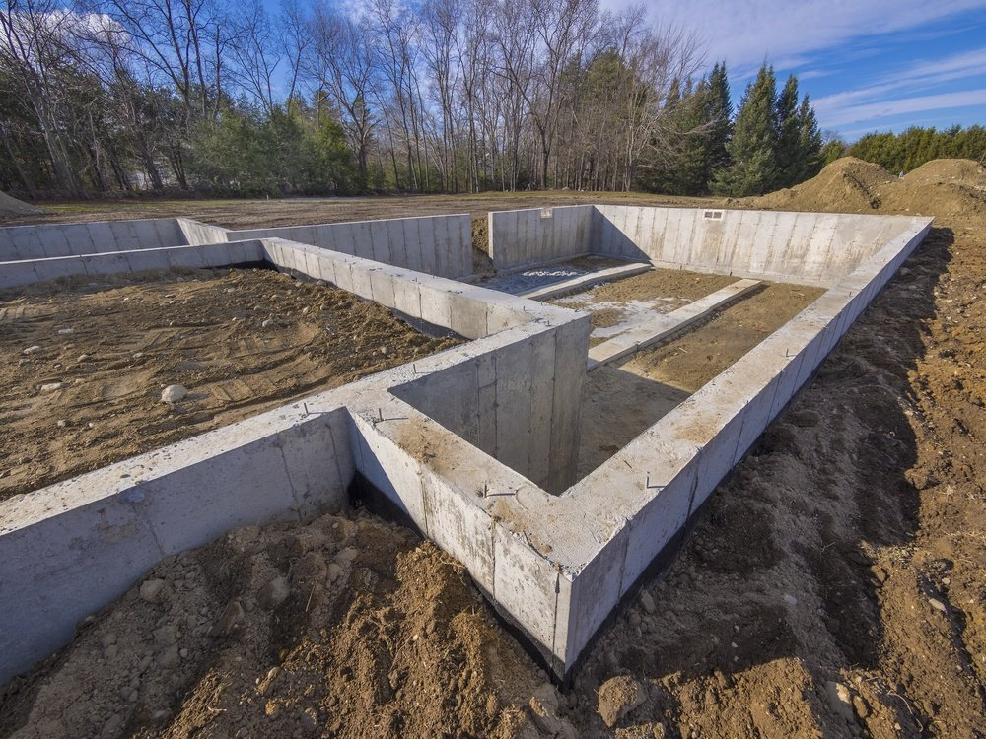
Secondary Modifiers / Characteristics
All Modifiers – Including Primary Ones – Will be Set to a Default Value (Usually Unknown) in Each Model
Secondary modifiers are characteristics outside of primary characteristics that affect losses
Most clients will only provide a few usable modifiers
Most important secondary modifiers for hurricane portfolios
Roof age
Roof material
Roof geometry
Siding type
Each model has documentation on what modifiers are captured for each peril
This will be provided when you reach the training sessions pertaining to each model
Secondary modifiers are only applied if primary modifiers are coded
General tip:
If you see something that might link to a modifier in the models, create an assumptions doc stating what column you’re looking at and what you think each entry should be mapped to

Slide 10
Lines of Businesses
Lines of Businesses Help Determine Occupancy Types
HO3 & HO5
Homeowner’s Insurance
Typically Single Family Home
HO4
Renter’s Insurance
Typically Multi Family Home
HO6
Condo Insurance
Condo / Apartments
HO7
Mobile Home Insurance
Typically Single Family Home
DP3
Dwelling Policy
Similar to HO3, but some coverages are added by default and others are optional
Typically used for properties being rented out
DP2
Rental Properties
Typically Multi Family Home
BOP
Business Owner’s Insurance
Commercial Lines
Many Options for Occupancy

Slide 11
Data Checks
Before Editing Raw Data, We Need to Make Sure What We Have is in Line with our Expectations
Easier to work with data in SQL, so import it there
Usually to a scratch server
Look at each column and decide if that information is relevant
Most checks will look like the query below:
SELECT [COLUMN], sum(tiv) as TIV, count(*) as count
FROM [clientrawdata]
Group by [column]
Order by [column]
Basically, you want to check the contents of each column to make sure the values present make sense
E.G. If the column “construction_building” had a value of “single family” or “pennies” that wouldn’t make sense
If it doesn’t look right, make sure the data was imported to SQL correctly or if there are errors in the raw data itself
You’ll also want to check geography info
Do the states, counties, etc. Make sense?
Make sure to omit commas in address columns (and all columns for that matter)
Check inception and expire dates – should cover a 1 year period

Slide 12
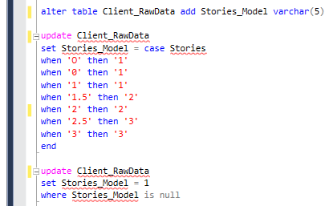
Data Edits
Editing Data Makes it Much Easier to Import Exposure Into the Models
Like checking data, we will need to go through each column and decide what the raw values mean
For example, we may use the query on the right to update entries for number of stories to
Not a bad idea to update NULL entries as unknown values
It’s also very important to create an assumptions document to share with the client
An assumptions document is a file that outlines what we are including on our import files
It shows the client what values we are mapping to and from for columns like construction and occupancy

Slide 13
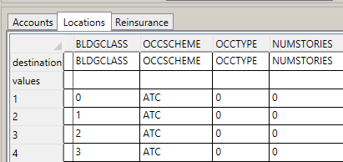
Intro to How Models Read Exposure
This Will be Covered More In-Depth in Future Sessions
The models will take you import file and will let you choose what each column means
The models will have their own definition of what their column names relate to and how they impact the results
If you name the columns of you import files exactly the way that each model sees it, you can automap all the columns at once
If we can edit the raw data to a format that the models understand, importing the data and working with it will make the process much easier
Column From Import File
Column to be Mapped to

Slide 14
Useful Resources
I Suggest Creating a Folder in Your Working Folder that Contains All Useful Docs
RMS Documentation | R:\01_REFERENCES\Documentation\RMS\v18.1
RL_RB_DLM_180_RG.pdf
Outlines every column necessary / optional for successful import
Lists every primary modifier option
INTL_SecondaryModifiersApplicabilityList.pdf
List of every secondary modifier for each model and peril
AIR Documentation | This Website
Click Validation Rules for Exposure Data → Locations
The Locations link will have multiple tables for you to look up column names necessary for import as well as primary / secondary modifier options

Slide 15


